Slide 1

Proof of concepts
Azure Security Scenarios

Slide 2
agenda
Goal: Showcase a combination of (attack + mitigation) on a specific Azure resource
DDoS attack on a web Application hosted on a Virtual Machine
1
XSS attack on a web Application hosted on a Azure Web App (App Service)
2
SQL injection attack on a Web Application (Web App + SQL DB)
3
Virus attack on a Virtual Machine
4

Slide 3
Steps
Step 0
day 0.
Step 1
Deploy workload and components
Step 2
Perform an attack
Step 3
Detect that an attack has happened
Step 4
Mitigate the specific attack, and if possible put in preventative measures
Step 5
Perform another attack. This time the attack should not have been successful

Slide 4




DDoS Attack: On a Web Application hosted on a Virtual Machine
Mitigation: Host the VM inside an Azure VNet with DDoS switch enabled
RG-WORKLOAD
RG-WORKLOAD
VNet
VNet
DDoS enabled
Before
After

Slide 5



XSS attack on a web App hosted on a Azure Web App (App Service)
Mitigation: Configure Application Gateway WAF to run in prevention mode
RG-DMZ
RG-DMZ
VNet
VNet
Application Gateway WAF in Detection Mode
Application Gateway WAF in Prevention Mode
RG-WORKLOAD
RG-WORKLOAD
Web App
Web App
Before
After

Slide 6
SQL injection attack on a Web Application (Web App + SQL DB)
Mitigation: Turn ON - SQL Database Threat Detection & Configure Firewall
RG-DMZ
VNet
RG-WORKLOAD
Application Gateway WAF in Detection Mode
VNet
Configure Server level Firewall
Turn ON - SQL Database Threat Detection
RG-WORKLOAD
VNet
Web App
Web App
Before
After

Slide 7


Virus attack on a Virtual Machine
Mitigation: Use the Antivirus console to Quarantine/disinfect files.
RG-WORKLOAD
RG-WORKLOAD
VNet
VNet
RG-SECURITY
RG-SECURITY
VNet
quarantine
VNet
TrendMicro Console
TrendMicro Console
Before
After

Slide 8











Virus-Attack-On-Virtual-Machines
DevOps Engineer
View Recommendations
Apply Remediation
<prefix>-virus-attack-on-vm-workload
<prefix>-virus-attack-on-vm-workload
VM w/o Endpoint Protection
VM with Endpoint Protection
BEFORE
AFTER
Virus Attack
Virus Attack

Slide 9
Azure Security Center Endpoint Supported Platforms
Platform | Azure Security Center Endpoint Recommendations | Notes
Windows 2008 R2 | Yes | Installs Endpoint protection and reports logs to OMS
Windows 2012 R2 | Yes | Installs Endpoint protection and reports logs to OMS
Windows 2016 | Yes | Installs Endpoint protection and reports logs to OMS
Ubuntu Server 16.04 LTS | ASC do not detect Linux operating systems for Endpoint Protection
Ubuntu Server 14.04 LTS | ASC do not detect Linux operating systems for Endpoint Protection
Red Hat Enterprise Linux 7.3 | ASC do not detect Linux operating systems for Endpoint Protection

Slide 10
SQL injection attack on a Web Application (Web App + SQL DB)
Use case 1
-sql-injection-attack-web-app
SQL DB Threat Detection Disabled
Application Gateway WAF in Detection Mode
BEFORE
SQL Injection Attack

Slide 11
SQL injection attack on a Web Application (Web App + SQL DB)
Use case 2
-sql-injection-attack-web-app
View Recommendations
DevOps Engineer
SQL DB Threat Detection Enabled
Apply Remediation
Application Gateway WAF in Detection Mode
Turn ON - SQL Database Threat Detection
BEFORE
SQL Injection Attack

Slide 12
SQL injection attack on a Web Application (Web App + SQL DB)
Use case 3
-sql-injection-attack-web-app
SQL DB Threat Detection Enabled
View OMS logs
Application Gateway WAF in Prevention Mode
DevOps Engineer
Enable WAF in Prevention Mode
AFTER
SQL Injection Attack

Slide 13
XSS (Cross Site Scripting) attack on a Web Application
Use case 1
-xss-attack-web-app
Application Gateway WAF in Detection Mode
BEFORE
XSS Attack

Slide 14
XSS (Cross Site Scripting) attack on a Web Application
Use case 2
-xss-attack-web-app
View OMS logs
Application Gateway WAF in Prevention Mode
DevOps Engineer
Enable WAF in Prevention Mode
AFTER
XSS Attack

Slide 15

DDoS Attack: On a Web Server hosted on a Virtual Machine
DevOps Engineer
DPS: DDoS Protection Service
DDoS Attack alert notification
<prefix>-ddos-attack-on-vm-workload
<prefix>-ddos-attack-on-vm-workload
DPS : Basic
DPS : Standard
DDoS Attack
DDoS Attack

Slide 16
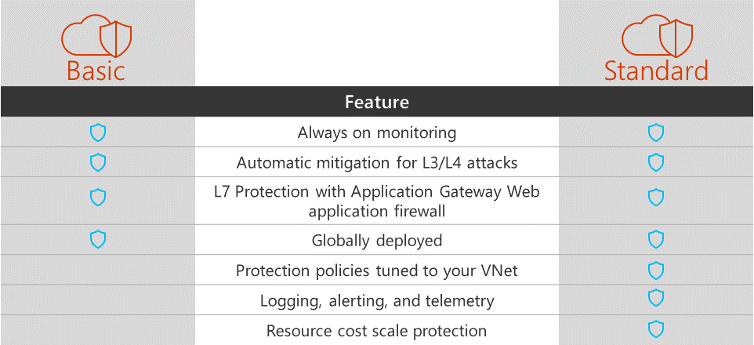
https://azure.microsoft.com/en-in/blog/azure-ddos-protection-service-preview/

